Slide 1


IPSP: An image processing and storage pipeline
Group 5
Vũ Hữu An
Lưu Thiện Việt Cường
Đàm Quang Đức
Lại Trí Dũng
Nguyễn Trọng Tâm
20225467
20225477
20225483
20225486
20225527
3

Slide 2

TABLE OF CONTENTS
I. ABOUT OUR PROBLEM
II. DATA INGESTION LAYER
III. STREAMING PROCESSING LAYER
IV. STORAGE LAYER
V. SERVING LAYER

Slide 3

I. ABOUT OUR PROBLEM

Slide 4

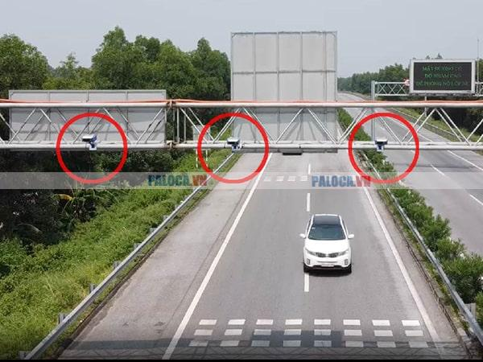
I. ABOUT OUR PROBLEM
I. OUR PROBLEM
Peak hour traffic causes severe urban congestion daily.
Real-time image data provides vital traffic insights.
→ Optimize routes to reduce total travel time.
→ Efficiently monitor flow using AI-driven analysis.

Slide 5






I. ABOUT OUR PROBLEM
Pre - processing
Storage
input
LMDB format
distributed storage
convert
store
produce
Serving
Stream Processing
Ingestion
convert
store
consume
visualization
nosql database
data processing
message queue

Slide 6
II. DATA INGESTION LAYER

Slide 7
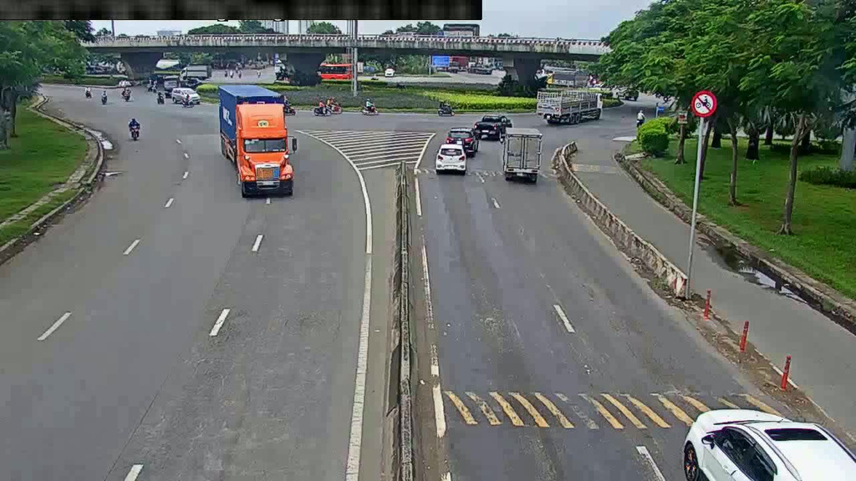
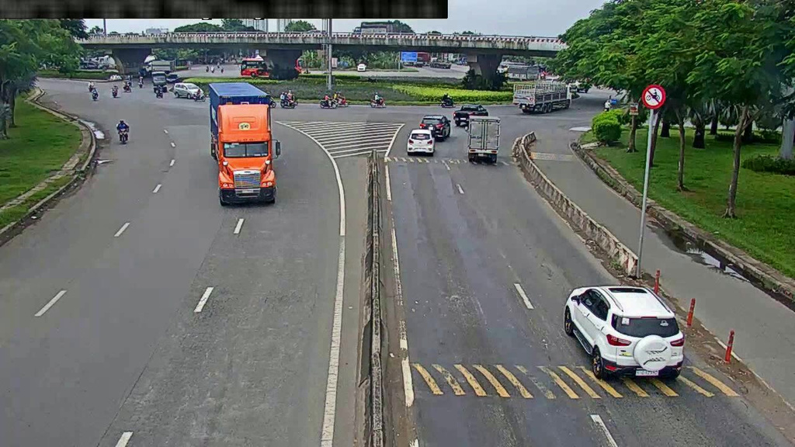
II. DATA INGESTION LAYER
1. Data Source
Competition dataset contains 10,000 images of 10 cameras.
Images include corresponding labels for object detection.

Slide 8
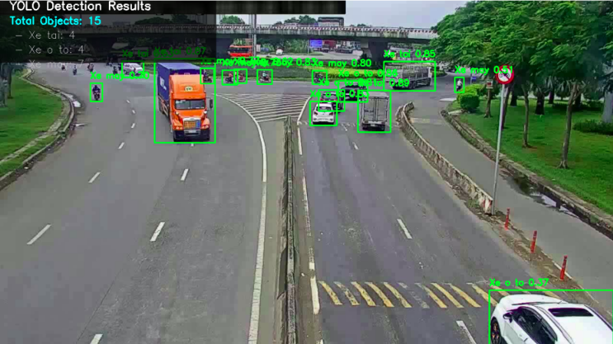
II. DATA INGESTION LAYER
2. Data Preprocessing
Bounding Box Label

Slide 9
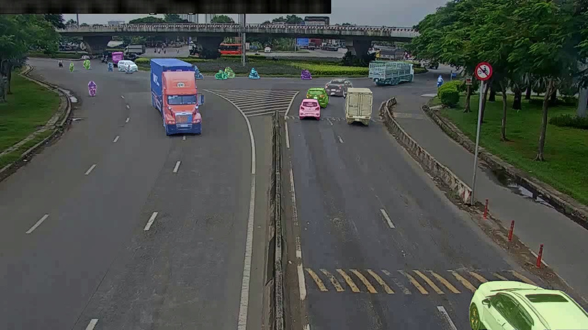
II. DATA INGESTION LAYER
2. Data Preprocessing
Segmentation Label

Slide 10
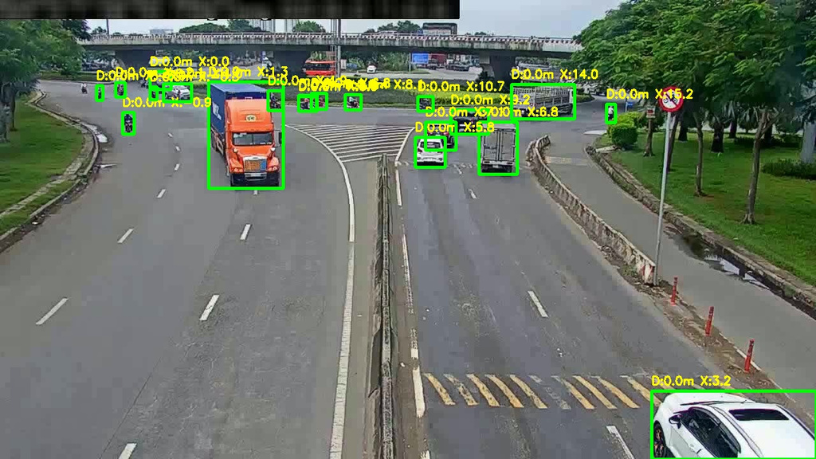
II. DATA INGESTION LAYER
2. Data Preprocessing
2D World Coordinate Label

Slide 11
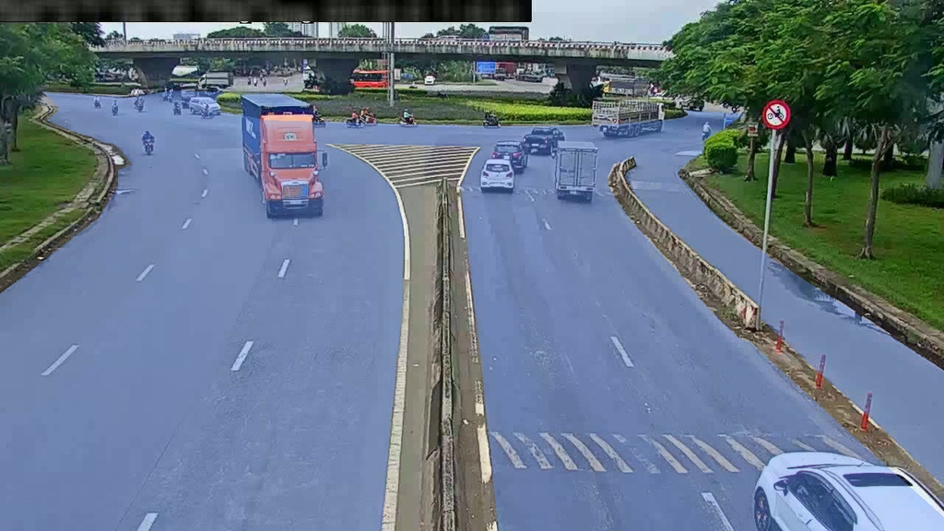
II. DATA INGESTION LAYER
2. Data Preprocessing
Road Segmentation Label

Slide 12
II. DATA INGESTION LAYER
2. Data Preprocessing
Data processed are converted to LMDB format.
LMDB format data are stored in Minio.
Key | Value
cam_01_00001 | FF D8 FF E0 00 10 4A 46 49 46 00 01 02 00 00 01
cam_01_00002 | FF D8 FF E0 00 10 4A 46 49 46 00 01 02 00 00 01
cam_01_00003 | FF D8 FF E0 00 10 4A 46 49 46 00 01 02 00 00 01

Slide 13
II. DATA INGESTION LAYER
3. Data Ingestion
Traffic Camera Producer
Simulates live traffic camera feeds
Reads serialized image data (LMDB).
Maps camera_id to specific Kafka partitions.
Sends binary/JSON payloads to Kafka topic: traffic_data.
Kafka Cluster
Deployed on Kubernetes using StatefulSets for persistence.
Configured with 10 partitions to match 10 camera streams.
Acts as a decoupling layer and backpressure buffer.

Slide 14
II. DATA INGESTION LAYER
4. Data Flow
{
"camera_id": "cam_01",
"frame_id": 1,
"timestamp": "2025-01-01T00:00:00Z",
"road_geometry": [],
"objects": [
{
"track_id": 10001,
"class_id": 3,
"bbox": [747, 188, 814, 276 ],
"depth": 22.1,
"world_coordinates": {"x": 6.77, "y": 4.91},
"segmentation": [ [ [ 761,191] ] ]
}
]
}
Producers extract images from LMDB and generate simulated real-time traffic events.
Incoming messages are buffered in the Kafka topic traffic_data using UTF-8 JSON for metadata and Base64/Binary for images.
Key-based Partitioning: Ensures all frames from cam_01 always land in Partition 0.

Slide 15
III. STREAM PROCESSOR LAYER

Slide 16
III. STREAM PROCESSOR LAYER
1. Spark deployment
Deployment: Single replica Deployment running a containerized PySpark.
Resource Management: 1Gi RAM request and 2Gi limit streaming stability.
Execution Engine: Configured in local[*].
Integration Strategy:
Ingestion: Consumes real-time event from Kafka.
Sink: Streams processed insights into MongoDB via authenticated connection strings.

Slide 17
III. STREAM PROCESSOR LAYER
2. Data transmission
01
02
03
03
Deserialization
Configuration Lookup
UDF
Window Aggregation
Parse JSON and decode Base64 images into tensors.
Fetch "Road Masks" from MinIO (cached at executor level).
Run algorithms to compute indicators.
Aggregate data by 1-minute sliding windows using Watermarking (30s) to handle late-arriving frames.

Slide 18
IV. STORAGE LAYER

Slide 19
V. SERVING LAYER
1. Minio
Deployment: StatefulSet with 1 replica.
Storage: 10Gi Persistent Volume.
Credentials: Root access configured with custom username/password.
Service Strategy:
API: Port 9000 (ClusterIP) for programmatic data ingestion (Producer/Spark).
Console: Port 9001 (ClusterIP) for browser-based object management.

Slide 20
V. SERVING LAYER
1. Minio
Example Structure
/traffic_data/
├── models/
│ ├── rtdetr_traffic_best.pt
│ ├── yolov8_traffic_best.pt
│ ├── yolo11n_traffic_best.pt
├── raw_lmdb/
│ ├── cam_01.lmdb
│ ├── data.mdb
│ ├── lock.mdb
└ ├── cam_02.lmdb

Slide 21
V. SERVING LAYER
2. MongoDB
Deployment: StatefulSet with 1 replica.
Storage: 5Gi Persistent Volume.
Database Version: Official Mongo 6.0 image.
Service Strategy:
Internal: Port 27017 (ClusterIP) for Spark Sink and Metabase connection.
Security: Root authentication enabled with predefined administrative credentials.

Slide 22
V. SERVING LAYER
2. MongoDB
{
"_id": {"$oid": "69486d3c963d9b1eb60866dd"},
"camera_id": "cam_08",
"timestamp": "2025-12-21T21:56:47.139164",
"insights":
"{\"camera_id\": \"cam_08\",
\"timestamp\": \"2025-12-21T21:56:47.139164\",
\"density\": {\"percentage\": 10.36},
\"unique_counts\": {\"motorcycle\": 18, \"car\": 1, \"bus\": 1, \"truck\": 0},
\"avg_speeds_frame\": {\"avg_speed_motorcycle\": 0.0, \"avg_speed_car\": 0.0, \"avg_speed_bus\": 0.0, \"avg_speed_truck\": 0.0}}"
}
traffic_per_second
Capture raw frame insights for immediate display.
Stream individual vehicle coordinates and speed data.
Append processed metadata directly to MongoDB collection.

Slide 23
V. SERVING LAYER
2. MongoDB
{
"_id":{"$oid": "69486e78963d9b1eb6089040" },
"start_time": {"$date": "2025-12-21T21:56:30Z"},
"camera_id": "cam_09",
"avg_density_pct": 10.16852213479028,
"unique_motorcycle_count": 162,
"unique_car_count": 27,
"unique_bus_count": 0,
"unique_truck_count": 0,
"avg_speed_motorcycle_kmh": 6.1324356206385,
"avg_speed_car_kmh": 8.359208500884437,
"avg_speed_bus_kmh": 4.326048888596408,
"avg_speed_truck_kmh": 0.22036747392175232
}
traffic_per_minute
Aggregate vehicle counts using one-minute sliding windows.
Calculate average speed and density per camera.
Update complete dashboard state every thirty seconds.

Slide 24
V. SERVING LAYER

Slide 25
V. SERVING LAYER
1. Metabase setup
Deployment: Single replica on Kubernetes with resource limits (2Gi RAM).
Storage: Internal H2 database stored at /metabase-data/metabase.db.
Service Strategy:
Internal: Port 80 (ClusterIP mapping to 3000).
External Access: NodePort for browser-based dashboarding.

Slide 26
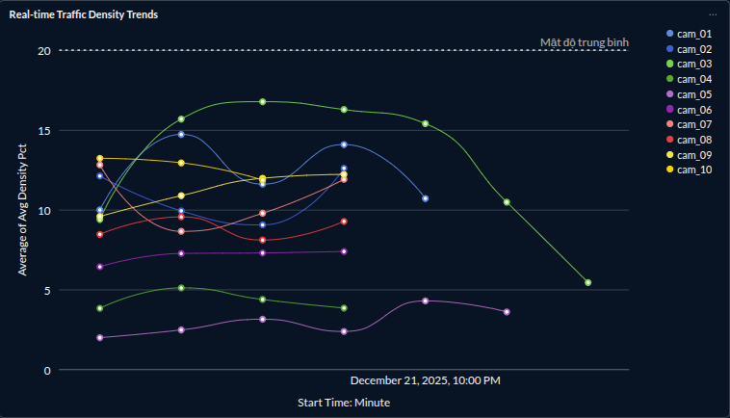
II. ACCOMPLISHMENT
2. Metabase dashboard
Real-time Traffic Density Trends
Visualization: Line Chart
Purpose: Monitor occupancy changes across live time series.

Slide 27
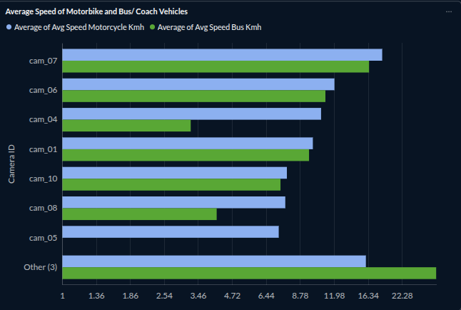
II. ACCOMPLISHMENT
2. Metabase dashboard
Average Speed of Motorbike and Bus/ Coach Vehicles
Visualization: Bar Chart
Purpose: Compare vulnerable motorcycles against heavy truck volumes.

Slide 28
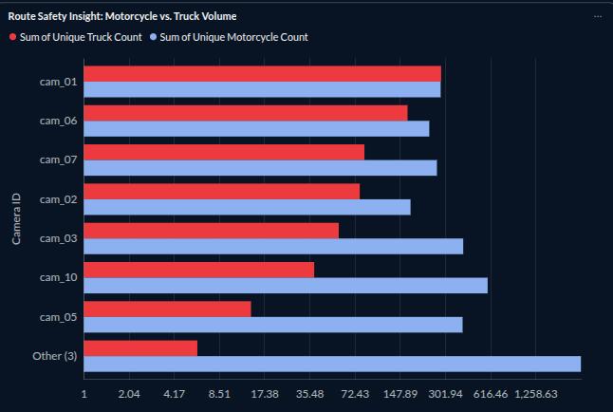
II. ACCOMPLISHMENT
2. Metabase dashboard
Route Safety Insight: Motorcycle vs. Truck Volume
Visualization: Line Chart
Purpose: Evaluate travel speeds for private and public transport.

Slide 29

THANK YOU !
13

